Slide 1
AI Assignment #3
Notes:
Hello. I’m here to announce third AI assignment.

Slide 2
Assignment #3
Pacman – Q Learning & Approximate Q Learning
http://ai.berkeley.edu/reinforcement.html
Only Question 7 & Question 8
Due date - 2017.05.19, 11:55 pm
No Late Submission is allowed.
Notes:
Third assignment is pacman AI project. This is an assignment from Berkeley for reinforcement.
What you have to do is to implement Q learning and approximate Q-learning for pacman.
Due date of this assigment is next Friday, and no late submission is allowed.

Slide 3
Grade
Total: 20 points
Ranking: 6 points
QLearningAgent_autograder: 5 points (1 question)
ApproximateQAgent_autograder: 9 points (3 questions)
Notes:
This assignment is 20-points assignments.
If your q-learning and approximate q-learning implementation is perfect, you got 14 points.
and your feature extractor for approximate q-learning will be checked by your ranking like previous sudoku assignment.

Slide 4
How to Test Autograder
Both:
python autograder.py
QLearningAgent:
python autograder.py -q q1
ApproximateQAgent:
python autograder.py -q q2
Notes:
This commands are for automatic grading your implementation.
Please check it later.

Slide 5
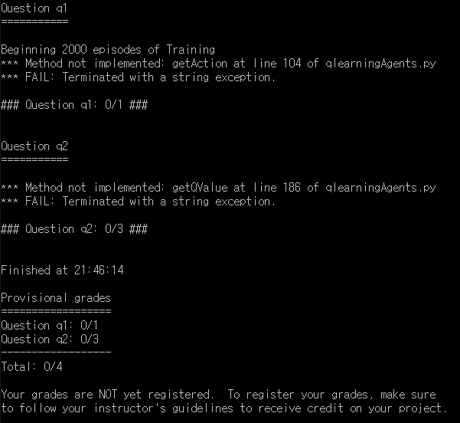
Autograder - Unsolved
python autograder.py
Notes:
So, when just execute autograder with given code, you can see like this screenshot.

Slide 6
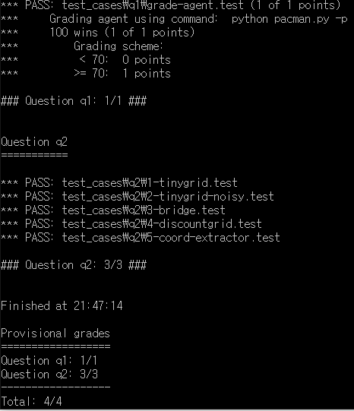
Autograder - Solved
python autograder.py
Notes:
And, when your implementation is finished, you will see scenes like this.

Slide 7
How to Test
QLearningAgent: python pacman.py -p PacmanQAgent -x 2000 -n 2010 -l smallGrid
ApproximateQAgent: python pacman.py -p ApproximateQAgent -a extractor=SimpleExtractor -x 50 -n 60 -l mediumClassic
Notes:
For fair grading, the number of training games and test is predetermined.
So, if you want to check your implementation, you can try these commands in the command window.

Slide 8
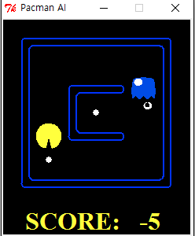
QLearningAgent
Notes:
This is a sample screenshot for Q learning agent

Slide 9
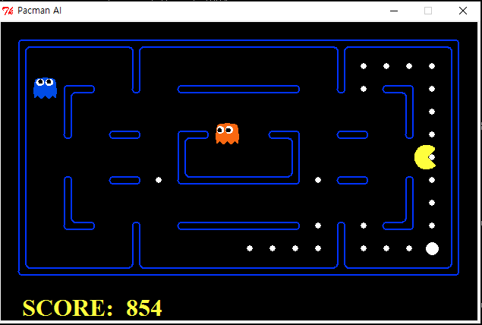
ApproximateQAgent
Notes:
And this is for approximate q agent.

Slide 10
TODO
qlearningAgents.py: Q-learning agents for Pacman.
featureExtractors.py: Classes for extracting features on (state,action) pairs. Used for the approximate Q-learning agent (in qlearningAgents.py).
Submit your score for “ApproximateQAgent”.
Remove “util.raiseNotDefined()” for each function you are implementing.
Notes:
To summarize, what you have to do is to implement two files (qlearningAgents.py and featureExtractors.py)
qlearningAgents is for basics of Q-learning algorithm, and featureExtractors is for custom feature extractor of approximate Q-learning.
If you implement all these files, you could submit your score of custom feature extractor.

Slide 11
qlearningAgents.py
class QLearningAgent:
getQValue
computeValueFromQValues
computeActionFromQValues
getAction
update
class ApproximateQAgent:
getQValue
update

Slide 12
featureExtractors.py
class SimpleExtractor(FeatureExtractor):
Use it by default
Do not modify
class CustomExtractor(FeatureExtractor):
To use enhanced feature
Write your own feature

Slide 13
Submit Score
ApproximateQAgent – Submit Average Score
You are only able to submit your score in this condition.
numTraining=50
numGames=60
agent=ApproximateQAgent
layout=mediumClassic
Can use different Feature Extractor
python pacman.py -p ApproximateQAgent -a extractor=SimpleExtractor -x 50 -n 60 -l mediumClassic

Slide 14
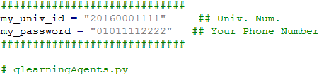
ID & Password
qlearningAgents.py

Slide 15
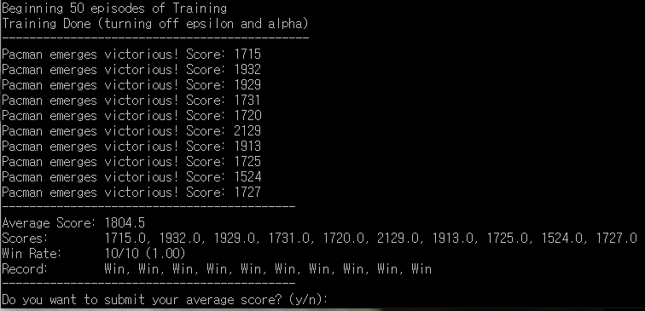
Steps (Example in Quiet Mode)
python pacman.py -p ApproximateQAgent -a extractor=SimpleExtractor -x 50 -n 60 -l mediumClassic

Slide 16
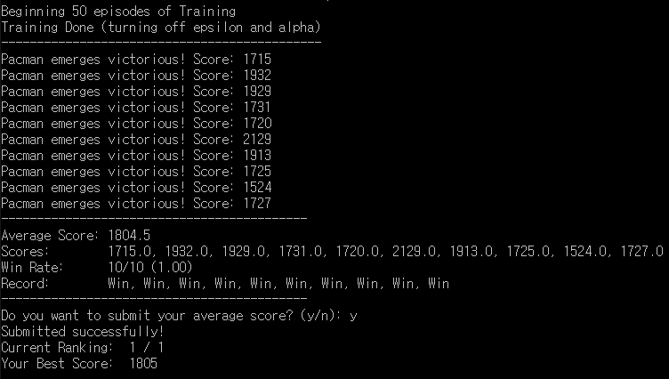
Steps (Example in Quiet Mode)

Slide 17
More Information
Pacman Score:
Eat Food: +10
Each Action: -1
Eat Ghost: +200
Win: +500
Lose: -500
Options:
Possible to change (python pacman.py --help)
Quiet Mode:
Get scores without any visualization.
Example – python pacman.py –q {your_options}

Slide 18
Submission
Create a UniversityNumber.zip (2015000000.zip) file
featureExtractors.py
qlearningAgents.py
Do not forget to submit your Average Score for ApproximateQAgent.

